Slide 1





All pictures copyright-free from pixabay
Notes:
Slide 1: Starry sky stilling exercise
Use the stilling slide if desired: the suggested words should be spoken slowly, leaving pauses in between to create a sense of stillness.
As you sit quietly, watch the stars twinkling….[PAUSE]
Now practise slower breathing…..in…..and out…..in……and out…..keep this going as you continue to look at the stars….[PAUSE]
You maybe notice that you are feeling calmer and more relaxed….[PAUSE]
We come into this special / sacred space and time to be still….to think deeply…..to be together as a school community…..
In our time together today, we will look at a puzzle and talk together, share the next part of our story and then use it to help us to think.
But first, let’s welcome one another as we begin….

Slide 2
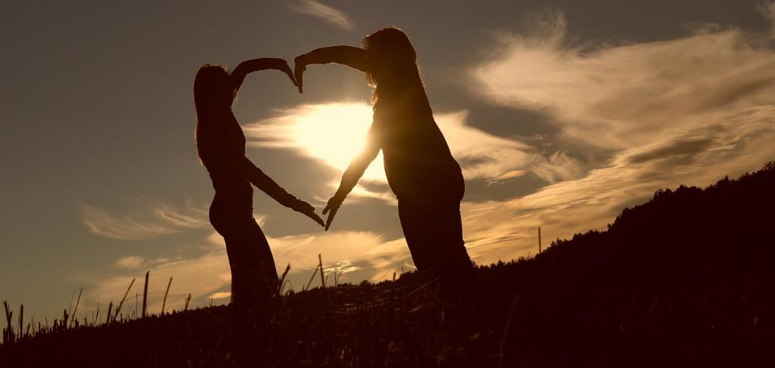
Leader: As we gather together today…
ALL: …we bring our thoughts and our hearts into this sacred space.
Notes:
Slide 2: Gathering
Leader: As we gather together today….
ALL: ….we bring our thoughts and our hearts into this sacred space.
Here are BSL actions for some of the words:
Leader’s words:
Gather: https://www.signbsl.com/sign/gather (1st video)
Today: https://www.signbsl.com/sign/today (1st video)
Pupils’ response:
Thoughts: https://www.signbsl.com/sign/thoughts (1st video)
Hearts: https://www.signbsl.com/sign/heart (1st video)

Slide 3

Spot the difference
Notes:
Slide 3: for younger children
We’re going to start today with a puzzle, and a question! I wonder if you have ever done one of these? – there are some differences to spot between the two trains. Let’s see how many differences you can find….
[Fruit in the carriage; colour and number of wheels; smoke from funnel; colour of light on the front]
Later on today, we’ll have a chance to think about another type of spot the difference puzzle together, but now….. let’s carry on with Daniel’s story.

Slide 4
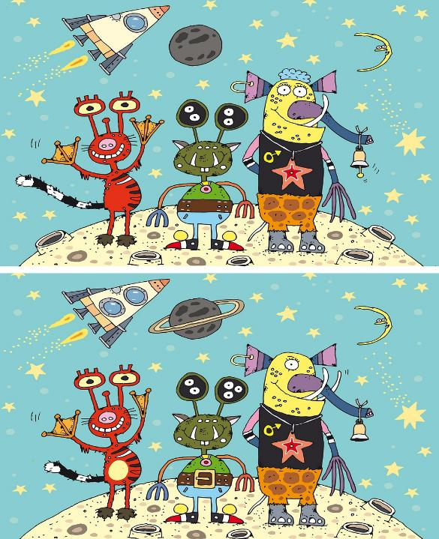
Spot the difference
Notes:
Slide 4: for older children
We’re going to start today with a puzzle, and a question! I wonder if you have ever done one of these? There are some differences between the top picture and the bottom one. Let’s see how many differences you can find….
[Here’s what we spotted!: Windows on the rocket; ring around the planet; red alien – missing web on one hand, short tail, tummy marking; middle alien – extra eye, buckle on belt; yellow alien – missing eye, missing tusk, missing hair, missing dong on bell; planet – missing crater]
Later on today, we’ll have a chance to think about another type of spot the difference puzzle together, but now…..let’s carry on with Daniel’s story.

Slide 5
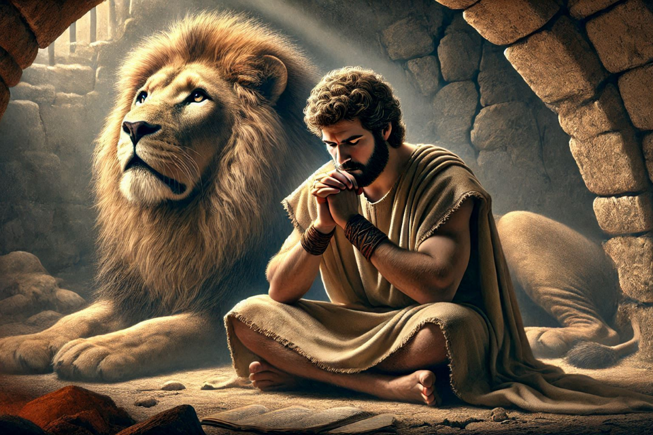
Shine like stars!
Notes:
Slide 5: We heard last week that God had given Daniel a special talent in understanding dreams – which seems an unusual thing to be able to do, but it does indeed come in very useful in this week’s part of the story….

Slide 6
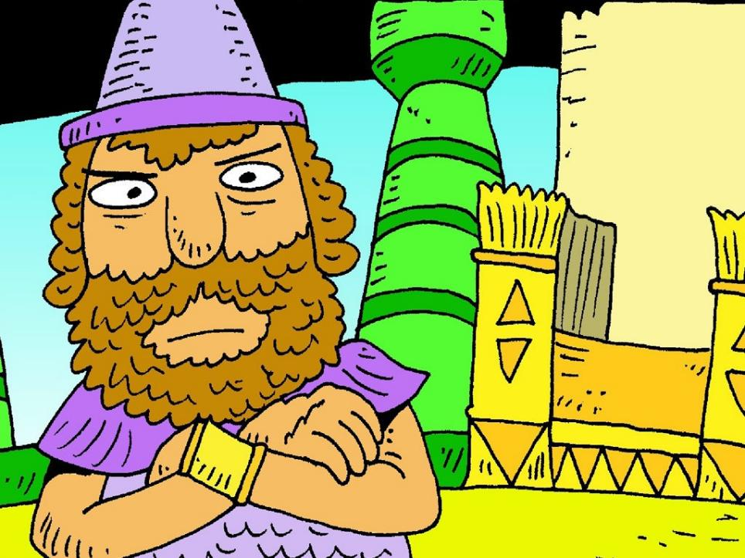

Notes:
Slide 6: …and that King Nebuchadnezzar was a very proud, powerful and bossy king and was very used to getting everything that he wanted. But his encounter with Shadrach, Meshach and Abednego had helped him to see things differently……or had it?.....

Slide 7
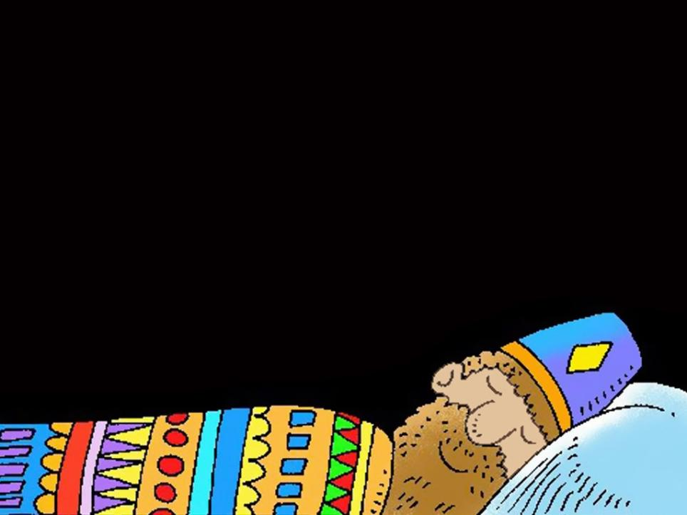
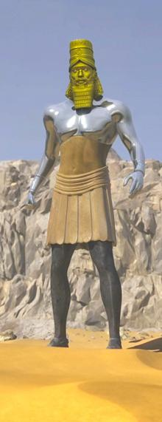
Notes:
Slide 7: In Daniel’s day, it was thought that dreams had special meanings and King Nebuchadnezzar often asked his advisers about the things that he dreamed…..and he dreamed about some very strange things!!

Slide 8
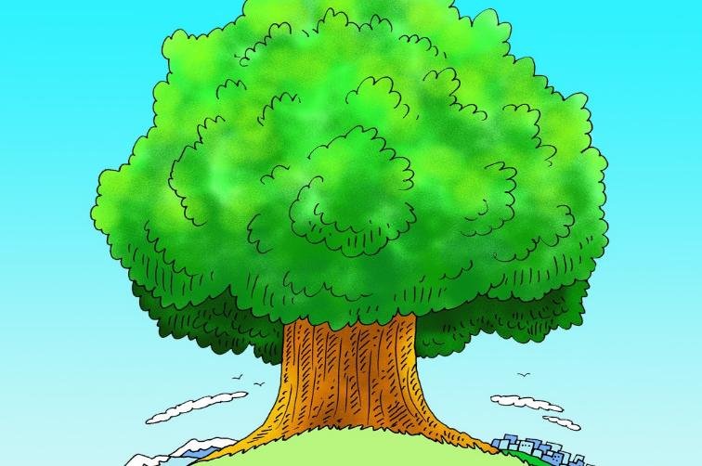


Notes:
Slide 8: One night, as he slept, he dreamed about a very large tree. It was so big it grew right up to the sky and its leaves spread all over the whole world.
The tree provided food for the animals and homes for the birds.

Slide 9
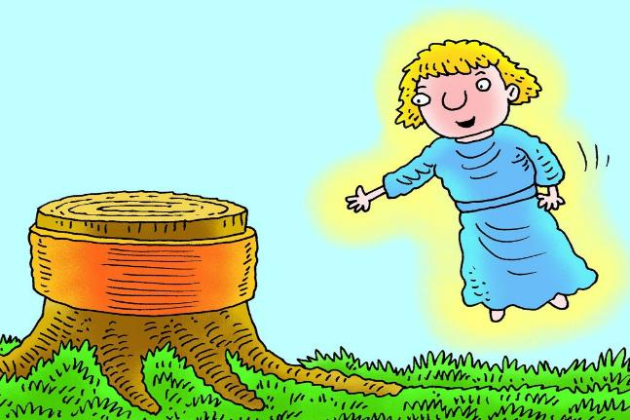
Notes:
Slide 9: As he watched, an angel appeared and ordered, ‘Cut down the tree, shake off the leaves and scatter the fruit. Drive the animals and birds away!’

Slide 10
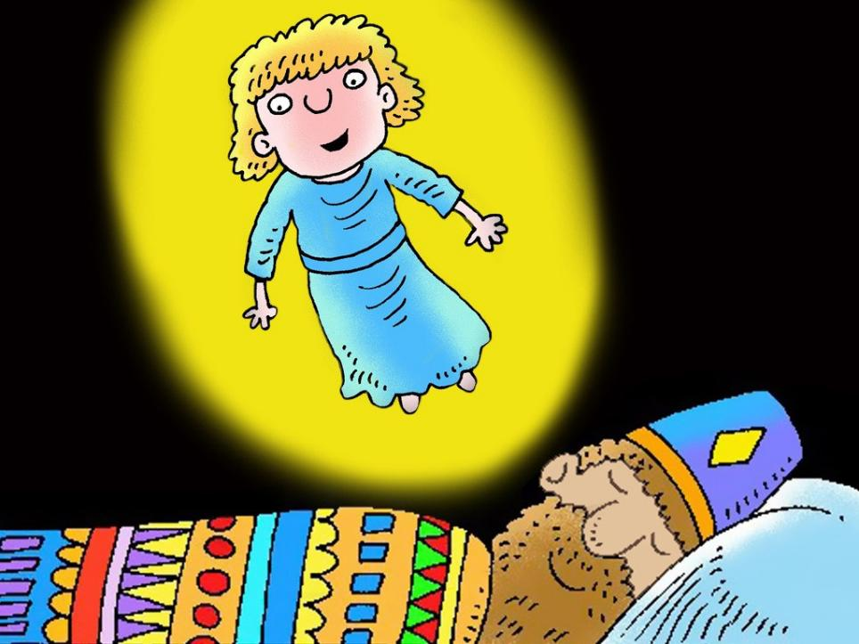
Notes:
Slide 10: Then the angel declared: ‘Let grass grow on him, and rain fall on him, and let him live like an animal.’ In his sleep, King Nebuchadnezzar felt that the angel was talking about him – and woke up with a start!

Slide 11
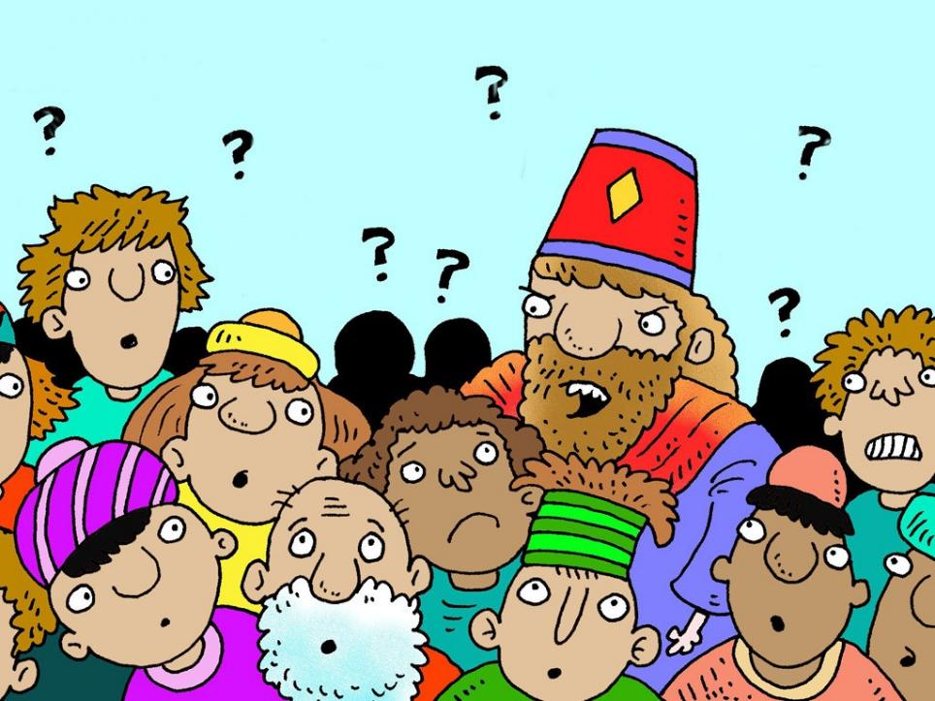
Notes:
Slide 11: The King summoned all of his wise advisers from across his kingdom, but not one of them could tell him what the dream meant.

Slide 12
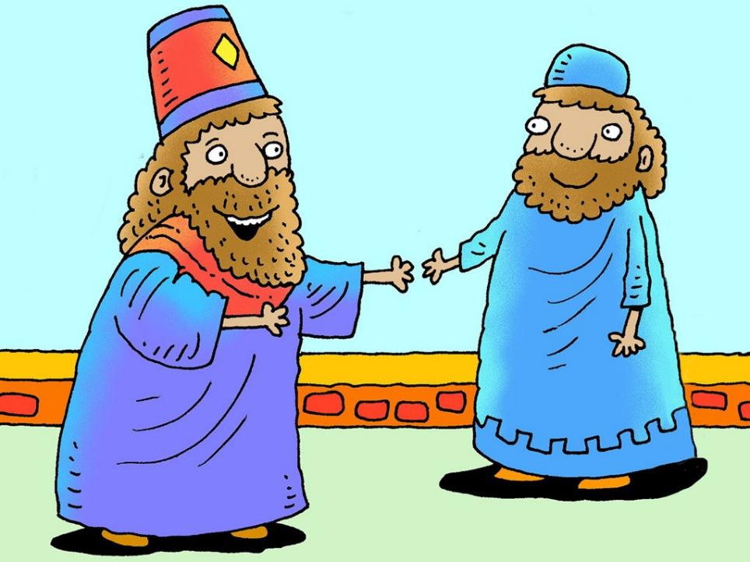
Notes:
Slide 12: Then Daniel came to visit King Nebuchadnezzar. ‘I know no secret troubles you,’ the king said. ‘Explain my dream to me. Do not let the dream or its meaning make you afraid.’

Slide 13
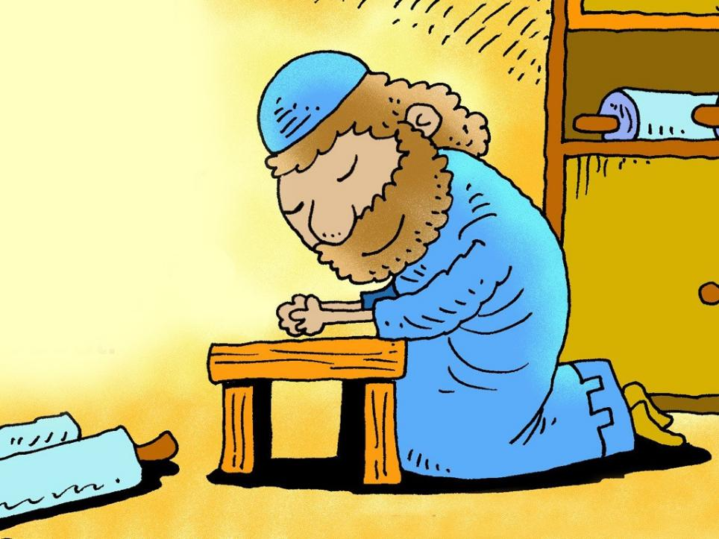
Notes:
Slide 13: Daniel went away and prayed to God, the King of heaven and earth, and asked him for his wisdom. Then returned to King Nebuchadnezzar with the meaning of the dream.

Slide 14
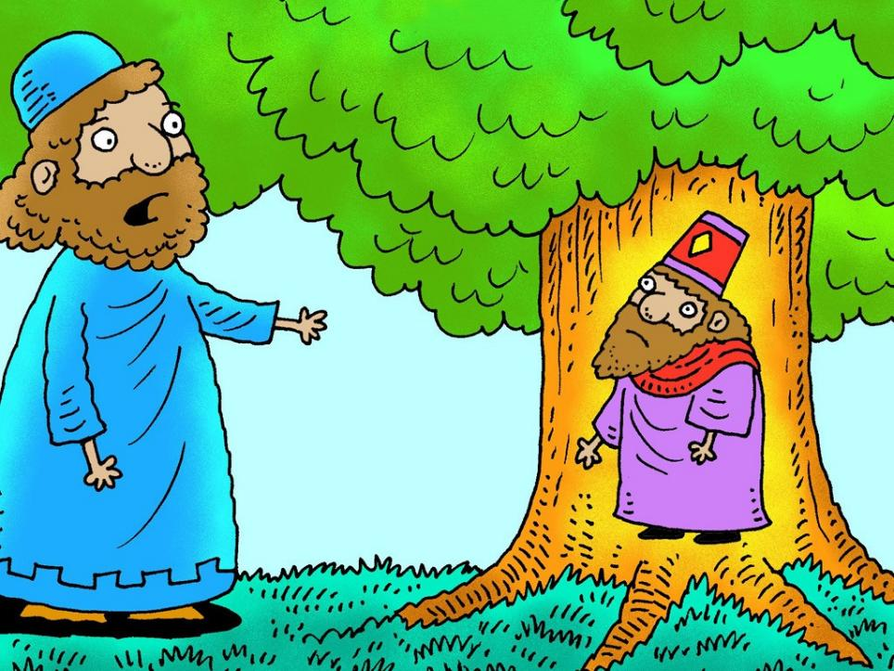
Notes:
Slide 14: ‘You, O King, are like the tall tree that touched the sky: your power reaches to the far parts of the earth. But you have not treated the people in your kingdom as you should, especially those who are poor: those whom you could have sheltered in the branches of your kingdom, you have treated cruelly. You are puffed up with pride and think you are more powerful than anyone else – even God! And so, like the tree, you will be cut down to size!’

Slide 15
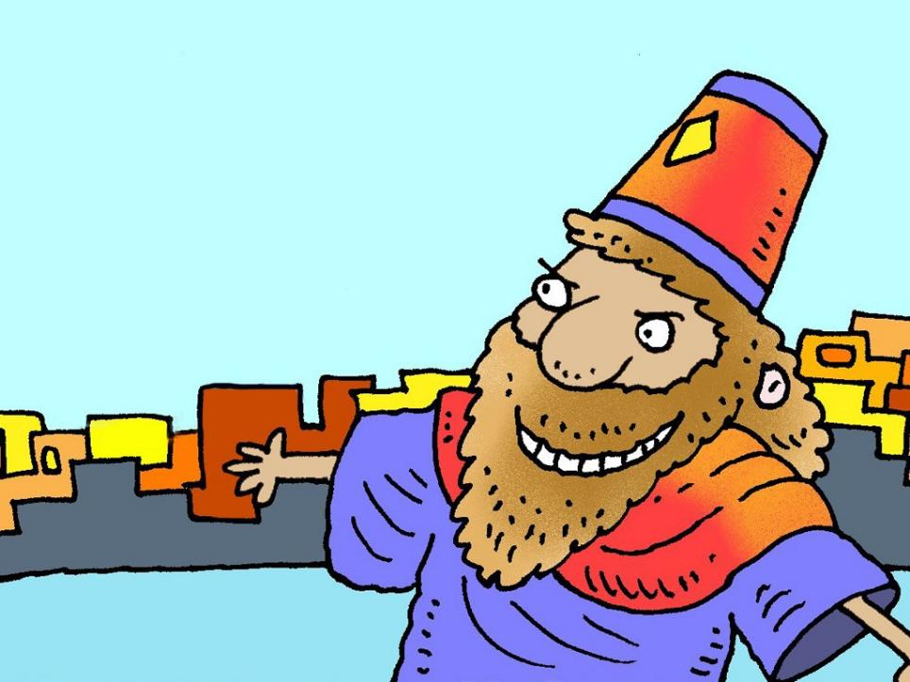
Notes:
Slide 15: Daniel left the King, but for a whole year nothing happened and so King Nebuchadnezzar forgot all about the dream, and God’s warning. His kingdom prospered and everything went well, until, one day he was looking at his magnificent palace and his heart swelled with pride. ‘This is my great empire,’ the king boasted. ‘I built it with my power. I am mighty. Look how important I have become! I am the King of the Universe*!!’
[*From an ancient inscription, it is believed that this is how Nebuchadnezzar thought of himself.]
What dangerous words – and how very unwise!!

Slide 16
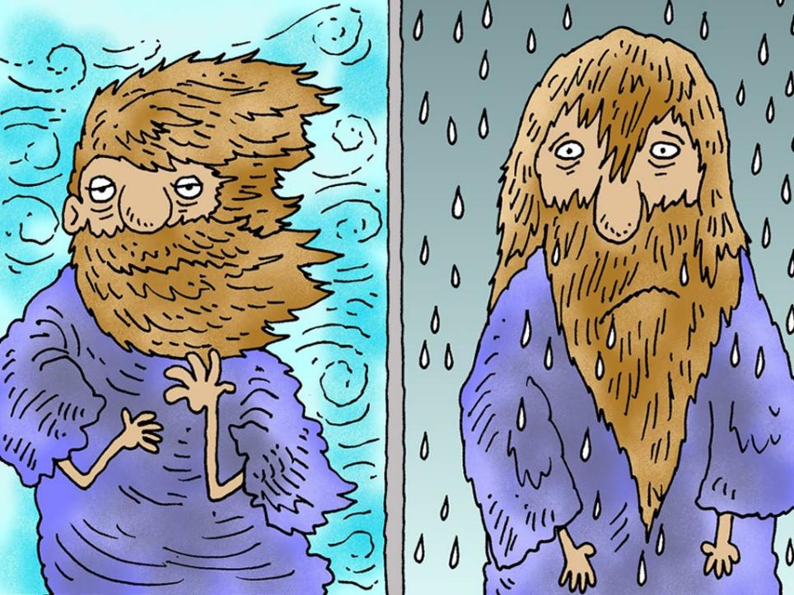
Notes:
Slide 16: And then, just like that, it happened as the angel had said it would: the king went mad and for seven years lived in the wilderness like an animal, in the rain and the wind…’ Until just as suddenly….

Slide 17

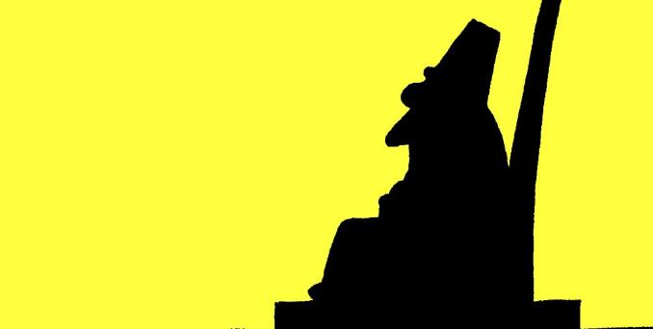
Notes:
Slide 17: ….he was better again, and ran, delighted back to his beautiful palace feeling rather different than before.
He now understood what God had meant in his warning – and how he should behave as King.
This story is the last time we hear about King Nebuchadnezzar in the book of Daniel – so we don’t really know what happened next…..except that a new King will follow him! More of that next week…..

Slide 18
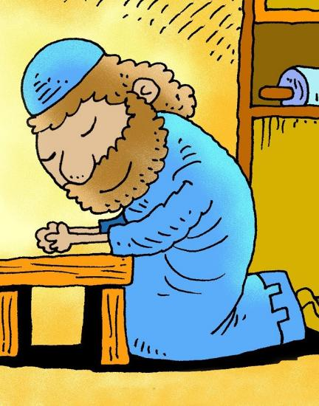
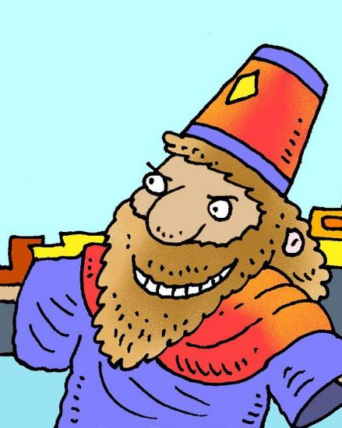
Spot the difference….
Notes:
Slide 18: We started our time today with a spot the difference puzzle: we are going to do a slightly different one now!
I wonder what differences there were between how Daniel behaved and how Nebuchadnezzar behaved in the story…. I wonder which one you would prefer was a leader in our school?!
You might want to talk to a partner now about your thoughts….. [gather some ideas, particularly focussing your thinking on how Daniel was humble and the King was proud. Draw out the meaning of the word ‘proud’ in this context – it’s not the same as being proud of something you’ve done well, though it can easily become a negative kind of proud!]

Slide 19

‘Pride comes before a fall.’
Notes:
Slide 19: There’s a very ancient proverb that says: ‘Pride comes before a fall.’ (Proverbs 18:12) It’s a warning that being proud in the wrong way can mean that, like King Nebuchadnezzar, our pride will trip us up. If we’re too proud, then we forget to be kind and generous to people and think that others should notice us or keep giving us praise for what we have done, or that we don’t have to follow the same rules as everyone else – and nobody likes that kind of leader!
But it’s also a reminder that, as King Nebuchadnezzar found, our pride will trip us up eventually.

Slide 20

….I wonder what difference King Nebuchadnezzar’s experiences might have made to how he ruled as King?....
….I wonder what difference this story might make to how we live as part of our school community?....
….I wonder what sort of a leader you would want to be?....
Notes:
Slide 20: Responding and words for worship
We’ve heard today about the strange things that King Nebuchadnezzar dreamed – and the strange things that happened when he didn’t pay attention to the angel’s warning in his dream. We also thought about leaders – and the differences between Daniel and Nebuchadnezzar.
Pause for a few moments now and think about what we might have learned from this story [leave pauses between each]…..about ourselves….about others….and maybe about God…..
Now let’s wonder together…..
….I wonder what difference King Nebuchadnezzar’s experiences might have made to how he ruled as King?....
….I wonder what difference this story might make to how we live as part of our school community?....
….I wonder what sort of a leader you would want to be?....
[We recommend that you give some time this week to talking in class about these pondering questions – the reflective materials will help with this.]
We’re going to be quiet and still for a few moments now before I use some words to pray, from another part of the Bible. You might want to make this prayer yours, or just listen to the words…..

Slide 21
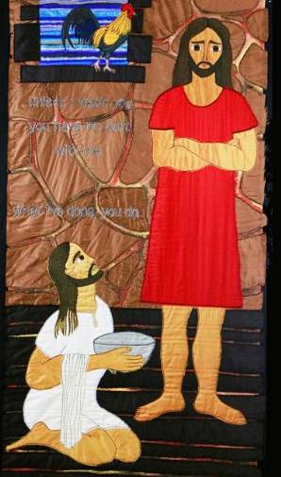
Dear God,
When we act, we pray that we would not let selfishness or pride guide our actions. Help us to be humble: to be interested in the lives of others and to give more honour to others than to ourselves.
May we think and act like Jesus, who was like you in everything.... yet made himself nothing, coming to earth to serve others….
Adapted from Philippians 2:3-7
Notes:
Slide 21: Prayer
They are some words about Jesus – you might remember this story of Jesus washing his disciples’ feet from Jacqui Parkinson’s panels last term.
Dear God,
When we act, we pray that we would not let selfishness or pride guide our actions. Help us to be humble: to give more honour to others than to ourselves and be interested in the lives of others. May we think and act like Jesus, who was like you in everything.... yet made himself nothing, coming to earth to serve others….
Adapted from Philippians 2:3-7*
*When you do things, do not let selfishness or pride be your guide. Be humble and give more honour to others than to yourselves. Do not be interested only in your own life but be interested in the lives of others. In your lives, think and act like Jesus, who was like God in everything and was equal with God. Yet he gave up his place with God and made himself nothing, coming to earth to serve others….

Slide 22


Slide 23
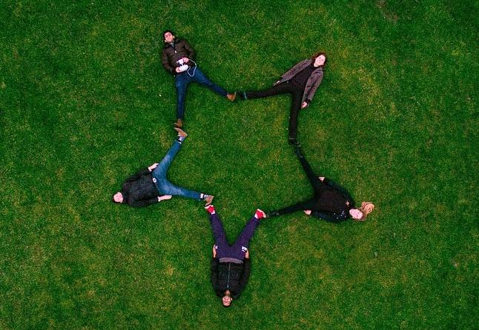


Leader: As we leave this place & time and go into the day ahead…
All: May we shine like stars!
Notes:
Sending: Slide 23
Leader: As we leave this place & time and go into the day ahead…
All: May we shine like stars!

Slide 24

Notes:
Slide 24: Reflective areas
Think: Who would you rather be like – Daniel or King Nebuchadnezzar?
Talk: What does this mean for how we might treat others this week? How might we serve each other and be wise in our actions towards others?
Do: Pick up a star and hold it in your hand. You might want to turn your thoughts into a prayer, like Daniel did.

